Slide 1

Cold Room AI Monitor
Advanced AI-Powered Monitoring for Optimal Cold Storage Management in Himachal Pradesh

Slide 2
Key Features at a Glance
Real-Time Monitoring
1
Instant access to temperature and humidity readings.
AI Spoilage Prediction
2
Proactive risk assessment using intelligent algorithms.
Anomaly Detection
3
Automatic flagging of abnormal environmental conditions.
Integrated Weather Data
4
External climate factors enhance prediction accuracy.
Customizable Alerts
5
Timely notifications via SMS for critical events.
These features combine to create a robust and intelligent monitoring solution, ensuring the integrity of your cold chain.

Slide 3
Revolutionizing Cold Storage with AI
Traditional cold storage management often relies on periodic checks, leading to potential spoilage and significant losses. The Cold Room AI Monitor addresses this challenge head-on, leveraging cutting-edge AI and real-time data to prevent spoilage and optimize operations.
This Flask-based system provides facility managers in Himachal Pradesh with unprecedented control and insight into their cold storage environments, protecting valuable perishable goods.
1
2
3
Prevent Spoilage
Optimize Efficiency
Ensure Quality
Minimize losses through proactive AI-driven predictions.
Streamline monitoring with real-time, automated insights.
Maintain ideal conditions for sensitive produce.

Slide 4
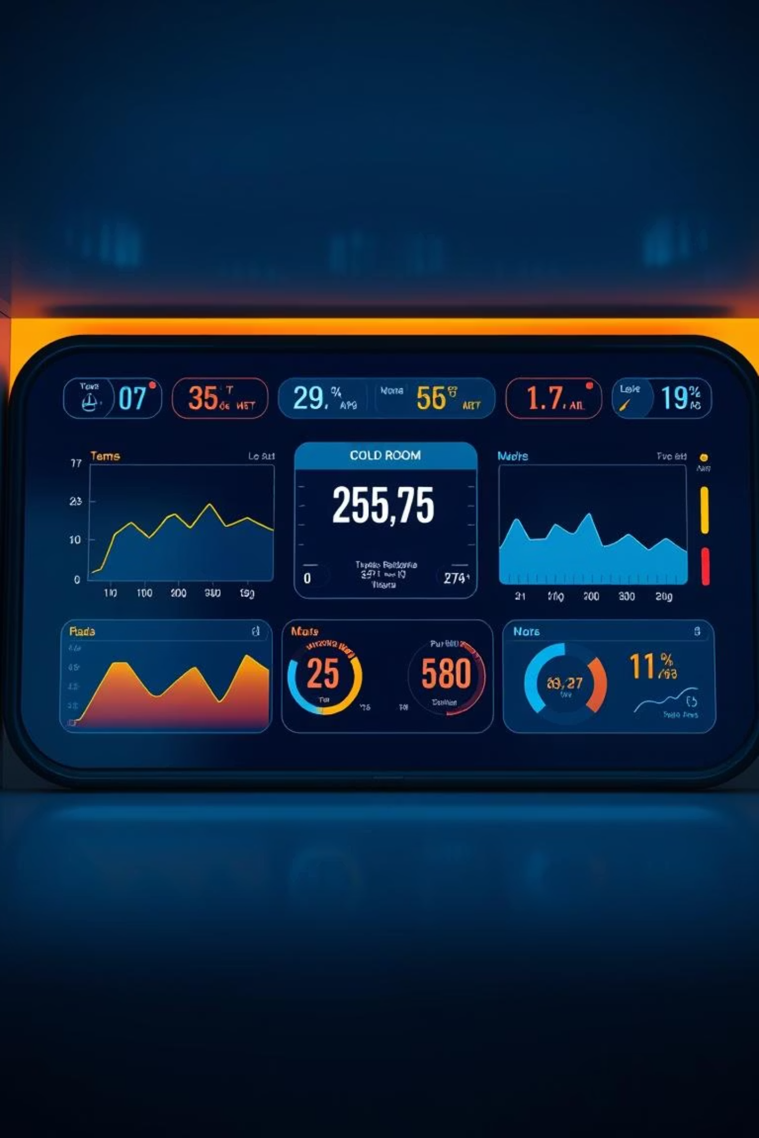
Real-Time Data & Intuitive Dashboard
The system features a sleek, dark-themed responsive UI, designed for clarity and ease of use. Facility managers can view the latest sensor readings at a glance, ensuring immediate awareness of cold room conditions.
Live Updates: Continuously streams temperature and humidity data.
User-Friendly Design: Optimized for readability and quick navigation on any device.
At-a-Glance Insights: Critical information is prominently displayed for rapid decision-making.

Slide 5
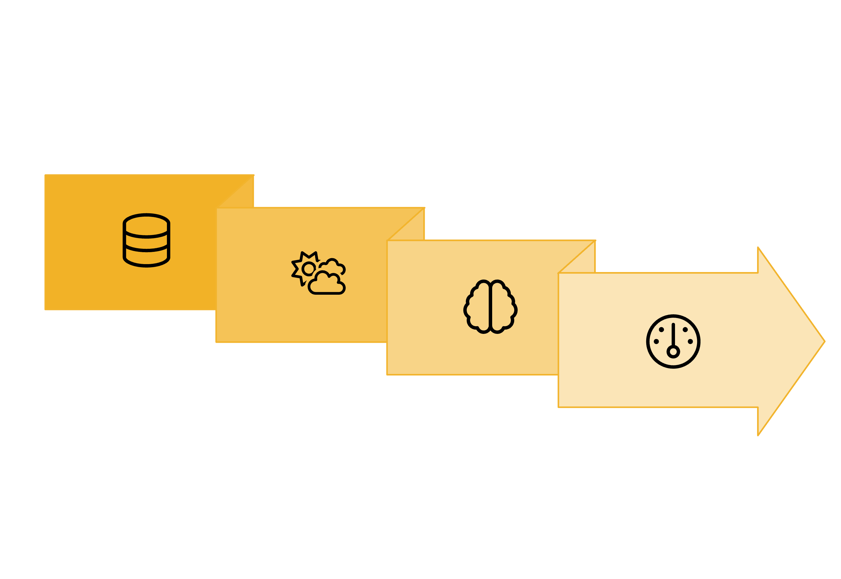




Intelligent Spoilage Prediction
At the core of the Cold Room AI Monitor is its sophisticated spoilage prediction engine. It combines internal environmental data with external weather conditions to provide highly accurate risk assessments.
External Weather
Risk Assessment
Internal Data
AI Algorithm
This predictive capability allows operators to intervene proactively, significantly reducing the risk of perishable goods deteriorating.

Slide 6
Anomaly Detection & Dynamic Ranges
The system goes beyond static thresholds by dynamically adjusting acceptable temperature and humidity ranges. This intelligence allows it to accurately flag abnormal conditions that might otherwise go unnoticed.
Adaptive Monitoring
Early Warning System
Ranges automatically adjust based on external climate via OpenWeatherMap API.
Instant alerts for deviations from optimal conditions.
Enables swift corrective action to prevent spoilage.
Reduces false positives and provides more relevant alerts.

Slide 7

Historical Data Visualization
Understanding trends is crucial for long-term cold storage optimization. The system provides powerful visualization tools to review past performance.
Temperature (°C)
Humidity (%)
Visualizing the last 100 readings via Chart.js helps identify patterns, validate optimal settings, and troubleshoot recurring issues. This data-driven approach supports continuous improvement in cold chain management.

Slide 8

Alerts, Notifications & Data Entry
Critical alerts are stored in the system's SQLite database for comprehensive logging and analysis. For immediate attention, the system can also send SMS notifications via Twilio, ensuring that facility managers are promptly informed of any critical events or anomalies.
SMS Notifications: Receive instant alerts on your mobile device for critical temperature or humidity deviations.
Manual Data Input: A failsafe option to manually enter readings when automated sensors are unavailable, ensuring continuous monitoring.

Slide 9










Tailored for Himachal Pradesh
The Cold Room AI Monitor is designed with the specific needs of Himachal Pradesh's cold storage operators in mind. Its location selection feature allows monitoring for multiple districts, catering to the diverse agricultural and commercial needs across the region.
Agricultural Focus
District-Specific
Ideal for fruit, vegetable, and produce storage.
Monitor cold rooms across various districts.
Commercial Use
Suitable for diverse perishable goods.
Customizable
Adaptable to unique facility requirements.
Local Weather
Integrates local weather for precision.

Slide 10





Key Takeaways & Next Steps
Enhanced Preservation
Cost Efficiency
Data-Driven Insights
Minimize spoilage and maximize product life.
Reduce waste and operational costs significantly.
Leverage historical data for continuous improvement.
Ready to transform your cold storage operations? Contact us for a personalized demo and discover how the Cold Room AI Monitor can benefit your facility.

